Slide 2


Keeping My Hands to Myself
Hugs can feel good.
My family hug me to show they care and love me.
My family hug me if I am sad or hurt.

Slide 3



Keeping My Hands to Myself
Is it OK to hug or touch anyone I want to?
No - they might not like this. Some people don’t like hugging.
This doesn’t mean they don’t like me.
image
I never hug strangers. I never hug people at school.

Slide 4






Who Can I Touch?
My parent or carer came to collect me from school.
I was happy to see them. I gave them a hug to show my love and happiness.
I went to the park with my family. I fell over and I felt sad. I put my hand out to my parent. They pulled me up and gave me a cuddle. I cried and felt better.
I tried my best at school. My teachers were really happy with me. My friend gave me a high five and smiled. I was happy and proud.

Slide 5
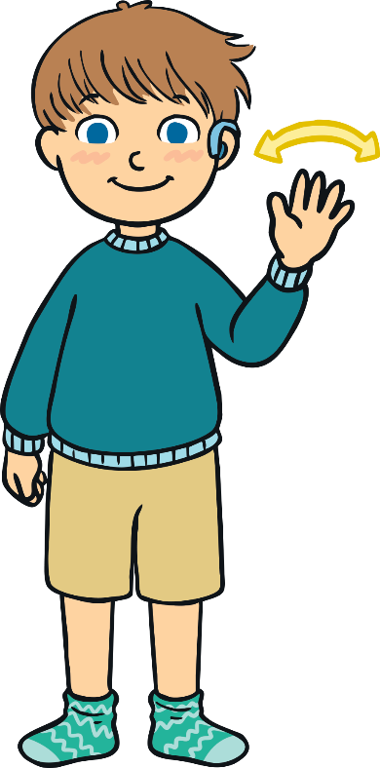

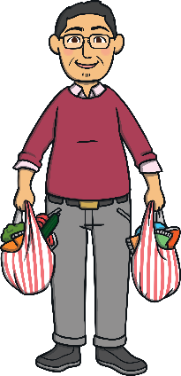
Who Can I Touch?
Somebody came to my school to look around. I didn’t know them. They said, ‘Hello.’ I smiled and said, ‘Hello.’ The rule is NO. I did not touch them. I did not hug them.
I went shopping. I saw a teacher. I waved at them and I said, ‘Hello.’ The rule is NO. I did not touch them. I did not hug them.
Somebody took my pen. I felt cross. I wanted to push them. The rule is NO. I told a teacher. I did not push them.

Slide 6

What Happens If I Touch Others?
If I touch others, I might annoy and upset them.
This might make my teachers or
friends feel sad.
I might get into trouble.
How would you feel if your friend
touched you but you did not like it?

Slide 7

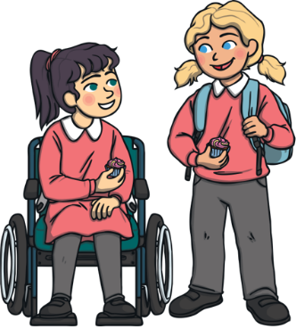






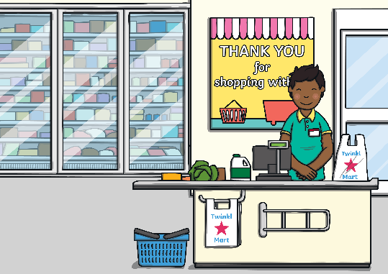


Your Turn
I want to hug my friend but my friend said, ‘No.’ Is it OK to hug them?
My teacher has a soft jumper on and I want to stroke it. Is it OK to touch it?
I am in a shop. I want to hug a stranger. Is it OK to hug them?

Slide 8

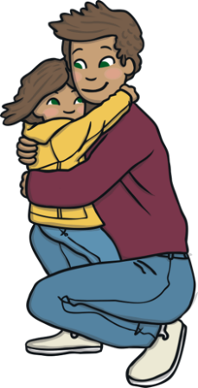






Your Turn
I tripped and hurt my knee. I feel sad. My parent wants to give me a hug. Is it OK to hug them?
My friend is happy. They won a game. They put their hand up to give a high-five. Is it OK to touch their hand and give a high-five?
My teacher is pleased with me. I can have a certificate. I want to touch the certificate. Is it OK to touch it?

Slide 9
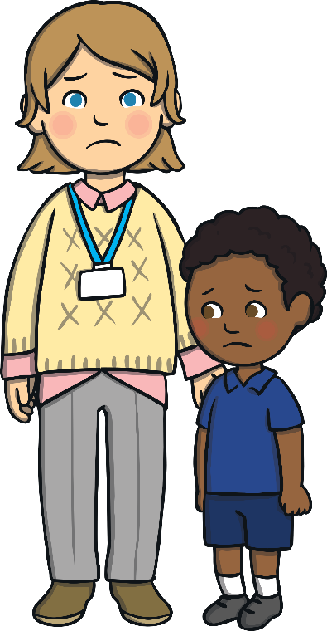

What Should I Do?
At school, I won’t touch my friends.
I won’t touch my teacher.
The rule is NO.

Slide 10


What Should I Do?
At school, I remember to keep my hands to myself.

Slide 11
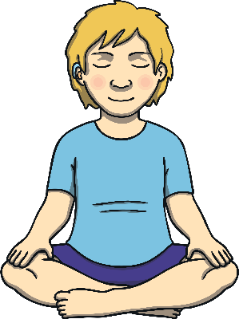
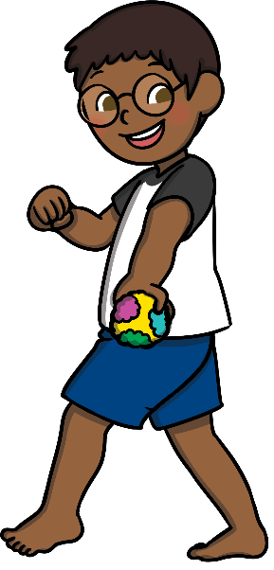


What Can I Do?
The rule is NO. At school, I remember to keep my hands to myself.
put my hands on my knees
play with a fidget toy
I can:
cross my arms
hold something soft
My teacher will help me. I will make my friends and teachers happy.

Slide 12


Keeping My Hands to Myself
The rule is NO. At school, I do not touch my friends or teachers.
I will try to remember to keep my hands to myself.
I will try to do something else instead of touching
other people.
My teacher will help me with this.
My friends will feel happy and we
can all play together.

